Slide 1
Safeguarding Children and Adults Level 1
Solent Safeguarding Team

Slide 2

Session outcomes – you will to be able to
Understand concepts of Safeguarding and Child Protection and how they relate to your job
Understand your responsibilities
Be able to recognise and respond to concerns appropriately
Know how to share information appropriately with other professionals

Slide 3
What is safeguarding?
“…means protecting a person’s right to live in safety, free from abuse and neglect.”
Department of Health (2017)
“Safeguarding means protecting people’s health, wellbeing and human rights, and enabling them to live free from harm, abuse and neglect. Its fundamental to high quality health and social care”
Care Quality Commission, online 2019
Safeguarding adults is a fundamental part of patient safety and wellbeing and the outcomes expected of the NHS. Safeguarding adults and Children is also integral to complying with legislation, regulations and delivering cost effective care.

Slide 4

Think Family / Family Approach
The ‘Think Family’ approach promotes co-ordinated thinking and delivery of services to safeguard children, young people, adults and their families/carers
Remember: Neither children, young people nor adults exist or live in isolation.
Even in these challenging times it is crucial that we consider not just our patient but also those that they come into contact/ live with. Where appropriate ask about family members , who lives at the home, are there children? Are there vulnerable adults are there people with care needs or learning differences.

Slide 5
Duties of health professionals and volunteers
All those that work within the NHS have a duty of care to protect people at risk of harm from others.
For safeguarding children, this is enshrined in the Children Act 2004, and Working Together 2018.
For adults, it is the Care act 2014
Both specify the need for local authorities, NHS and the police to work together to protect and safeguard children and adults at risk
While it can be difficult to know what to do and how to respond, you are not alone. Asking for advice is important if you are unsure. Do not hesitate, as the consequences could be life threatening.

Slide 6
Definitions of Abuse on Children
Inflicting harm, or failing to act to prevent harm
Children may be abused:
In a institutional or community setting
By another child
In a Family
By an adult or adults
By those known to the child
More rarely, by a stranger

Slide 7
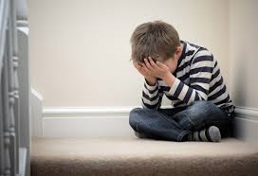
Categories of Abuse of Children
Neglect
Neglect : failure to meet a child's basic needs likely to result in serious impairment .
Consider things such as failing to adequately
supervise children. Failing to provide appropriate
medical care, failing to respond to child’s basic
emotional needs , inadequate food, clothing
hygiene etc.
Think about any contacts that you have with children within
your working day, do they look adequately cared for with
appropriate supervision for their age. Does the home environment
look suitably clean, do they have enough food, does their
appearance cause you any concerns.

Slide 8
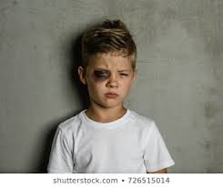
Categories of Abuse of Children
Physical Abuse
This could be shaking, throwing, poisoning, burning, drowning, hitting suffocating.
Within your working day please pay particular attention to those
children you may see with bruising or injuries to the facial , neck ,
top of shoulders and ear area , especially when there is not a
justifiable explanation, even then it is worth discussion with your
safeguarding team.
Non mobile babies are particularly vulnerable to physical harm,
therefore any bruise or injury seen on a baby that is non mobile
i.e. not crawling , bottom shuffling etc. you should contact our team
to discuss what you have seen or heard from the parent.

Slide 9

Categories of Abuse of Children
Sexual Abuse
Child sexual abuse is when a more powerful person (adult) uses a less powerful person (child) for sexual gratification.
A sexual act between two minors, where one exerts power over the other, is also considered sexual abuse.
This can take the form of :
Non-touching abuse: exposure to pornography, taking photos of children
in a sexualised manner, communicating in a sexual way via phone
or internet
Touching abuse: kissing, intercourse, fondling, oral sex and
attempted intercourse.
During your working day consider things that you might hear or see that
could be an indication of child sexual abuse. This could be children
acting in sexually inappropriate ways for their age, inappropriate sexual
language.

Slide 10
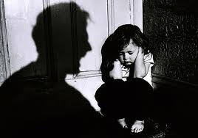
Categories of Abuse of Children
Emotional Abuse
Abuse that expresses to a child that they are worthless, flawed, unloved, unwanted or only of value when meeting another's needs.
In your working day consider those children that you come into
contact with that appear depressed, have hostility or high levels
of stress. Consider what you might hear or observe in relation
to parents communication and language to the child.

Slide 11
Vulnerable Children
Important to be particularly alert to the need for early help and support for a child who:
Has disabilities including learning needs
Unaccompanied asylum seeking children
Young carer
Living in families where drug, alcohol misuse, adult mental health issues and domestic abuse are present
Is misusing drugs or alcohol themselves
Going missing from home or leaving home for long periods ( especially in this current climate) as this could be an indication of criminal or sexual exploitation or radicalisation.

Slide 12
Referrals to Children's Social Care:
Anyone who has concerns about a child’s welfare should make a referral to local authority children’s social care and should do so immediately if there is a concern that the child is suffering significant harm or is likely to do so.
The person who has made a referral should always follow up their concerns if they are not satisfied with the response.
We should include any information known on the child’s developmental needs, the capacity of the child’s parents or carers to meet those needs and any external factors that may be undermining their capacity to parent.
Any known factors in relation to COVID-19 should be shared.
If appropriate and the child is not at immediate risk then seek support from Solent Safeguarding Team or your line manager in relation to making a referral.
Working Together 2018

Slide 13
If you believe that a child is at immediate risk of harm/ danger then call the Police.
Especially consider this in relation to if you observe a child being physically or sexually harmed, or you witness/ hear domestic verbal or physical abuse where a child is potentially present.
Young children that appear to have been abandoned at home or adults who are not responding and young children are clearly in the home.
Working Together 2018

Slide 14
Making a referral to Children's Social care:
Telephone MASH for the relevant local authority
State clearly that you wish to make a referral
Follow up your referral in writing, within 48 hours, using the inter-agency referral form (statutory requirement)
Follow up your referral after 3 working days, if you have not heard back from Children’s Social Care
If you believe that appropriate action is not taken by Children’s Social Care – then discuss with your line manager or Safeguarding Team who will have knowledge of how to escalation this.

Slide 15
Safeguarding Adults
The Care Act 2014 1/2
Under Section 42 of the Care Act - the LA has duty of care to make enquires where the adult:
Has needs for Care and Support (whether or not the LA is meeting any of those needs)
AND
Is experiencing or at risk of abuse or neglect
AND
As a result of those care and support needs is unable to protect themselves from either risk of, or the experience, of abuse and neglect.

Slide 16
Care & Support Needs 2/2
Person unable to achieve 2 or more outcomes, so having significant impact to wellbeing such as:
Managing nutrition, personal hygiene and toilet needs
Being appropriately clothed
Maintaining habitable, safe home environment
Maintain family and personal relationships
Accessing work, training, volunteering, education
Access of facilities in local community, incl. transport, recreation
Carrying out care responsibilities adult has for a child
(Section 9 Care Act 2014)

Slide 17
TYPES OF ABUSE
Hate Crime
Honour Based Violence
Protected
Characteristics
Inappropriate Restraint
Forced Marriage
Misuse of medication
Female Genital Mutilation
Discriminatory
Physical
Institutional
‘Gaslighting’
Domestic
Abuse
Organisational
What are we talking about?
Self-Neglect
Sexual
Cyber abuse
Hoarding
Sexual Exploitation
Neglect/Acts
of Omission
Modern
Slavery
Abuse of trust by professionals
Financial/
Material
Human Trafficking
Psychological
Mate Crime
Groups Promoting Violence
Cuckooing
Radicalisation

Slide 18
The Care Act: six key principles of Safeguarding Adults
 | What this means for you and Solent NHS Staff:
Empowerment | Presumption of person-led decision-making and allowing the individual to give informed consent. People are encouraged and supported in making their own decisions.
Prevention | It is better to take action before harm occurs, therefore a proactive approach not a reactive process.
Proportionality | The response should be the least intrusive approach, and one that is appropriate to the presenting risks.
Protection | Provide support and representation to those in greatest need
Partnerships | Look to local solutions including services working within the individual’s community (Safeguarding is also a community responsibility)
Accountability | Being accountable and transparent in following and delivering the safeguarding process

Slide 19
What it means from a patient perspective:
Empowerment
“I am asked what I want as the outcomes from the safeguarding process and these directly inform what happens.”
Prevention
“I receive clear and simple information about what abuse is, how to recognise the signs and what I can do to seek help.”
Proportionality
“I am sure that the professionals will work in my interest, as I see them and they will only get involved as much as needed.”
Protection
“I get help and support to report abuse and neglect. I get help so that I am able to take part in the safeguarding process to the extent to which I want.”
Partnerships
“I know that staff treat any personal and sensitive information in confidence, only sharing what is helpful and necessary. I am confident that professionals will work together and with me to get the best result for me.”
Accountability
“I understand the role of everyone involved in my life and so do they.”

Slide 20
Making Safeguarding Personal
- Practical Ways of Involving the adult
Being asked their choices and preferences
Empowering adults through access to advocacy
Use of communication aids where appropriate
Participation in decision making
Setting shared goals – working together
Pre-meeting visit to venues
Pre-meeting discussions (what to expect? Areas of concern?)
Pre-meeting introductions with other agencies/professionals
Post-meeting debrief – how was it for them?

Slide 21
Immediate action to be taken following a concern or disclosure of abuse
Ensure the safety of yourself & the individual and if in immediate danger, contact the relevant emergency services such as police, ambulance.
Gain consent from patient if able.
Report the incident / concern to your manager on duty or supervisor.
Do not go into investigative mode (focus on accurate, detailed record keeping).
Make a referral to the appropriate Adult Social Services. Follow the Referrals to Social Care flowchart – see Intranet)
Remember to consider the 6 principles - i.e. Make Safeguarding Personal

Slide 22
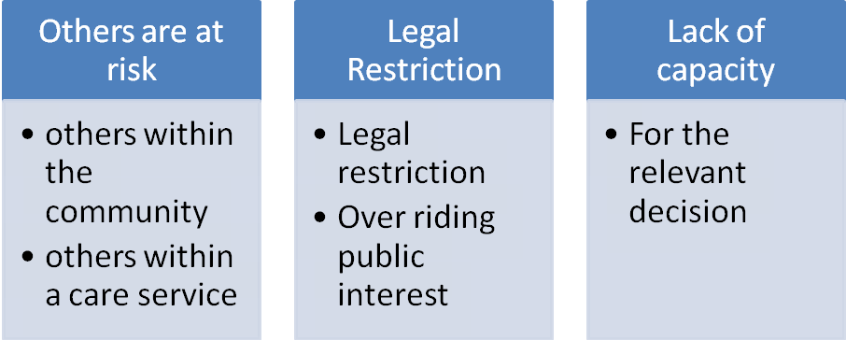
Consent exceptions
A patient’s right to make choices about their own safeguarding does not extend to making decisions that impact upon others or violate their right to be safe.

Slide 23
Domestic Abuse
“Any incident, or pattern of incidents of controlling, coercive or threatening behaviour, violence or abuse, between those aged 16 years or over, who are or have been, intimate partners, or family members, regardless of gender or sexuality.
This can encompass but is not limited to the following types of abuse: Physical, sexual, emotional or financial. This includes forced marriage and so called honour based violence (HBV), and female genital mutilation (FGM).”
(Home Office, 2015)

Slide 24
Statistics
On average a victim endures 35 separate acts of violence before calling the police.
It is estimated that an incidence of domestic abuse takes place every 2.5 seconds.
Between two and three women are killed by their partner or ex-partner every week in the United Kingdom.
44% of all crimes reported by women to the police are domestic abuse.
At least 750,000 children will witness DA every year*
75% of children subject to Child Protection Plans live in households where DA occurs.
More than 34,000 children in England and Wales are housed in refuges annually

Slide 25
Remember
Use your professional judgement
Be human and use everyday language - people may not see themselves as victims of domestic abuse. It’s hard to talk about, so acknowledge that and thank them for being honest with you
Consider if consent is required to take action
Consent can be overridden if children are at risk of or are suffering harm
Act on it - it took a lot of courage for the victim to tell you. Don’t keep what you know to yourself. The victim and family needs you to help them get help.
Seek advice

Slide 26
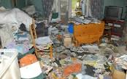
Self Neglect – manifests in different ways
It may be that a person:
Is unwell and unable to care for themselves
Is mentally unwell and unable to meet their own care needs
Has suffered trauma or loss resulting in the Person neglecting themselves
Does not recognise the level of neglect
Seek support from your manager and/or Safeguarding Team

Slide 27
Professional Challenge and Escalation
“At times we may disagree about the decisions or actions taken…”
Possible areas of disagreement could include:
Whether the we agree with social care response to a safeguarding concern
Concerns about safeguarding case management
lack of action by an agency
Seek advice from your manager or your linked Safeguarding Team 0300 123 3917

Slide 28

Information Sharing
Seven Golden Rules
Remember that the Data Protection Act and GDPR is not a barrier to sharing information but acts as a guidance about how this should be done.
Be open and honest.
Seek advice – Line Managers and Safeguarding Team
Share with consent where appropriate.
Consider safety and wellbeing.
Information shared should be - necessary, proportionate, relevant, accurate, timely and secure.
Keep a record.
Be clear regarding the nature of the problem and purpose of sharing information, base it on fact, not assumption. Restrict it to sharing with those with a legitimate need to know.
Information should be relevant to specific incidents and limit your information to what is needed to support that specific situation at that time.

Slide 29
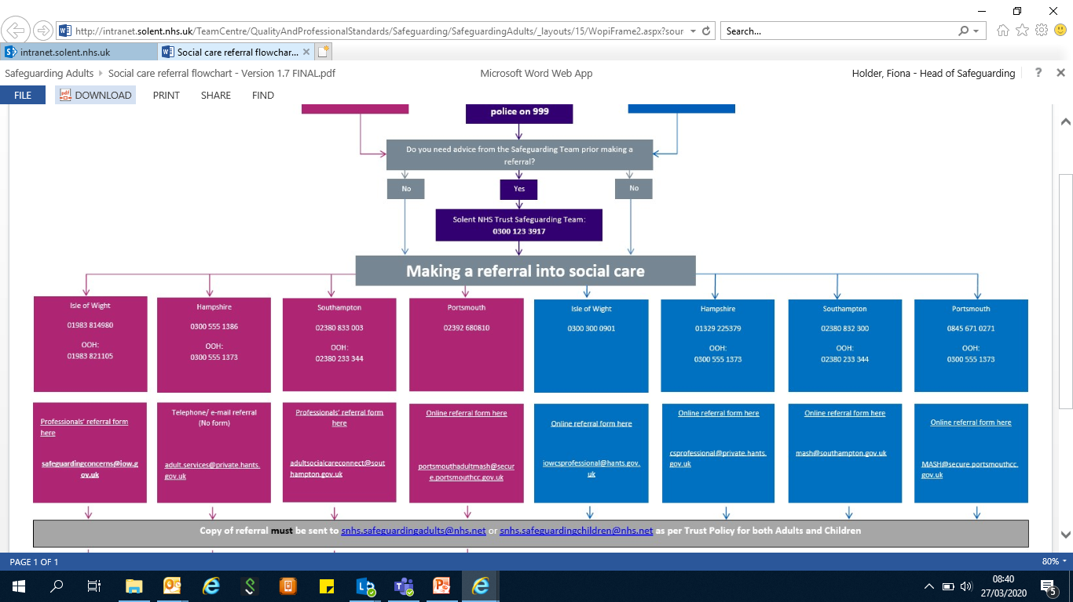
Solent Social Care Referral Flowchart 2020

Slide 30
Please be aware that the Solent referral pathway on previous slide is usually a live document on
Solent staff intranet that as volunteers you are unlikely to have access to.
The slide however provides the children and adult social care contact phone numbers for making referrals as required, along with email address.
To access the referral forms to make a referral you can telephone social care who will send you the link to the form or you can directly access the council websites
Southampton:
https://www.southampton.gov.uk/health-social-care/children/child-social-care/child-protection
Portsmouth
https://www.portsmouthscp.org.uk/worried-about-a-child-suffering-from-harm/
Hampshire
https://www.hants.gov.uk/socialcareandhealth/childrenandfamilies/safeguardingchildren/socialcareteams

Slide 31

Remember
Think Family

